Slide 1
IES Abroad
(The Institute for the International Education of Students )
Going to School in Taiwan
Chuing Prudence Chou (周祝瑛)
Professor, Cheng-chi University, Taiwan
Email: iaezcpc@nccu.edu.tw
Nov. 3 , 2008

Slide 2
You are going to share with me about Taiwan…
Why you need to know about Taiwan’s education?
What are the major features in Taiwan’s schools?
How you can compare these educational issues with other Asian and American counterparts?
How you relate Taiwan’s issues to China and even to the USA?

Slide 3
GNP per capita | 2007 (US$)
Taiwan | 17,252
America | 46,029
Japan | 35,424
Korea | 20,045
Singapore | 33,919
Source: Accounting and Statistics, Executive Yuan, Taiwan.

Slide 4
Population (2008 estimate)
305,556,000 (3rd)
Density31/km² (180th)
80/sq mi
Per capita$47,025 (6th)

Slide 5
Current Events that will affect Educational Policies in the USA and Taiwan

Slide 6
The US presidential campaign has entered the closing stretch with the two candidates making their final appeals for votes.

Slide 7
China vs. Taiwan
Cross-Strait Warming
Taipei - Taiwan and China are to hold a second round of ... thank his Taiwanese hosts. Chen, highest- ranking Chinese official to visit Taiwan since 1949, ...
Senior officials from Taiwan and China are scheduled to hold high-level talks this week ... of warming ties between the traditional rivals. Beijing's top negotiator Chen Yunlin is set to ... agenda are food safety issues after tainted Chinese milk products sickened at least three Taiwanese

Slide 8
Government and elections
Parties, ideology, and politics
Native Americans and European settlers
Educational implication

Slide 9
Demographics
Race/Ethnicity (2007)
White80.0%
African American12.8%
Asian4.4%
Native American and Alaskan Native1.0%
Native Hawaiian and Pacific Islander0.2%
Multiracial1.6%
Hispanic or Latino (of any race)15.1%

Slide 10
Education in the USA
Public education is operated by state and local governments.
Children are required in most states to attend school from the age of six or seven until they turn eighteen (the end of high school);
About 12% of children are enrolled in parochial or private schools. Just over 2% of children are homeschooled.

Slide 11
Diversity, Efficiency, and Equity

Slide 12
No Child Left Behind Act of 2001 (NCLB) standards-based education reform,
which authorized federal programs aiming to improve the performance of U.S. primary and secondary schools .
To increase the standards of accountability for states, school districts and schools (standardized test).
Parents’ school choice program
An increased focus on reading and re-authorized the Elementary and Secondary Education Act of 1965

Slide 13
Debates
Centralized and standardized test
Accountability
Equity

Slide 14
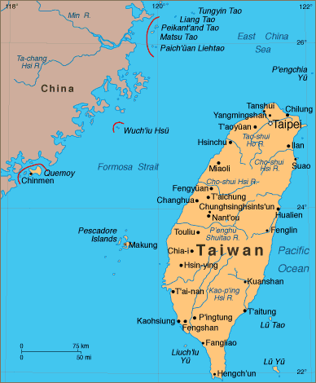

Slide 15
Spot Light : Taiwan
Area :36,000 square kilometers
Population: 23 million
Capital : Taipei City
Language : Mandarin/Taiwanese/Hakka/Indigenous Languages
Religion : Buddhism/Taoism/Christianity/Islam

Slide 16
Demographics
Population : 22.9 million (2005)
About 98% of the population is of Han Chinese ethnicity.
86% are descendants of early Han immigrants known as "native Taiwanese"
The most recent immigrants from mainland China after 1949.
Recent foreign spouses from Vietnam, Indonesia, Thailand and the Philippines

Slide 17
Transnational marriages now account for one out of six births.
The other 2% of Taiwan's population, numbering about 458,000, are listed as the Taiwanese aborigines

Slide 18
Literacy rate: 96.1%
• Men 97% • Women 95%
Enrollment 5,384,926
• Primary 2,153,717
• Secondary 1,676,970
• Post-secondary 1,270,194
Major problem: a drastic declining birth rate since late-1990s

Slide 19
Educational Implication
The New Generation/Sons of Taiwan with foreign mothers
Disadvantaged SES Background
Learning disadvantages

Slide 20
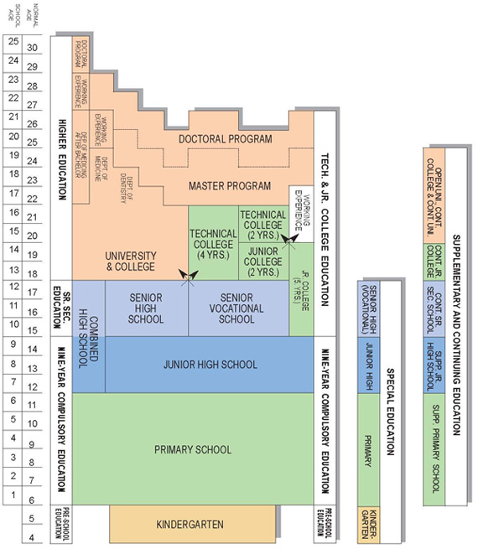

Slide 21
Preschool Education
Nine-Year Compulsory Education
Senior High and Vocational Schools
Special Education
Higher Education
Teacher Education
Supplementary and Continuing Education

Slide 22
A SCHOOL DAY(10th Grade)
Class period | Mon | Tue | Wed | Thu | Fri
7:10–7:20 | Clean campus
7:20–7:50 | Morning homeroom
7:50∼8:10 | Morning meeting
8:10–8:55 | Chinese | Science | English | Geo. | Chinese
9:10–9:55 | Chinese | Chinese | Science | Chinese | Art Performance
10:10–10:55 | Science | English | Math | English | Math
11:05–11:50 | Math | Health & P.E. | Integrated & Activities | Math | Art
11:50–12:30 | Lunch break

Slide 23
12:30∼13:10 | Nap time
13:20–14:05 | School meeting | Civics | Chinese reading | History | English conversation
14:15–15:00 | Class meeting | I & A | Music | English composi-tion | Science
15:00–15:25 | Clean campus
15:25–16:10 | Clubs | I & A | Health and P.E. | English composi-tion | Health & P.E.
16:20–17:05 | English | Math | Chinese | Science | English reading

Slide 24
Educational Reform in Taiwan
1987-88 : the external and internal environmental factors resulting in a series of nation-wide education changes
1989-93 : when the legislators passed many education bills and acts to ensure the reform policies to be based on throughout the country

Slide 25
1994-98 : the Committee of Education Reform under the Executive Yuan drew many representatives from all walks of life to design the theme, framework and progress of the reform, etc.
1999 to date : the numerous negative public opinions against the educational reform programs. The increasing gaps between the urban VS. rural and the rich vs. the poor.

Slide 26
4 Major Educational Issues
Globalization VS. Localization
Gender Stereotyping
Equity of Educational Opportunity
Family Educational expenditure on Cram Schools:
NT$2,640 (US$80) per subject / month

Slide 27
Cram schools
With the intense pressure placed on students to achieve, many students enroll in private after-school classes intended to supplement their regular education.
Popular subjects in cram schools include English, mathematics, and the natural sciences.
Classes are generally very orderly and controlled, with class sizes as high as 200 or so students.

Slide 28
Education Features
PISA 2006 Ranking | Math | Science | Reading Literacy
Taiwan | 1 | 4 | 16
Hong Kong | 3 | 2 | 3
Japan | 10 | 5 | 15
South Korea | 4 | 10 | 1
US | 24 | 20

Slide 29
TIMSS (2003) (13-year-old's average score, International Math and Science Study)
Countries: (sample) | Global rank | Math |  | Science
 |  | Score | Rank | Score | Rank
Singapore | 1 | 605 | 1 | 578 | 1
Taiwan | 2 | 585 | 4 | 571 | 2
South Korea | 3 | 589 | 2 | 558 | 3
Hong Kong | 4 | 586 | 3 | 556 | 4
Japan | 5 | 570 | 5 | 552 | 5
England | 10 | 498 | 18 | 544 | 7
United States | 12 | 504 | 15 | 527 | 11
Sources:TIMSS Math 2003 and TIMSS Science 2003

Slide 30
World-class University Rankings
As the provision of higher educational
opportunities becomes increasingly international,
institutional comparison becomes more in
demand.
The two most frequently cited rankings：
Shanghai Jiaotong University
Times Higher Education Supplement, London

Slide 31
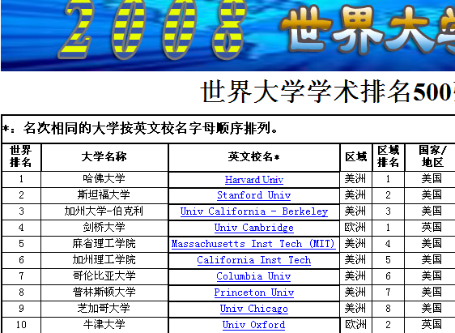
Shanghai Jiaotong University

Slide 32
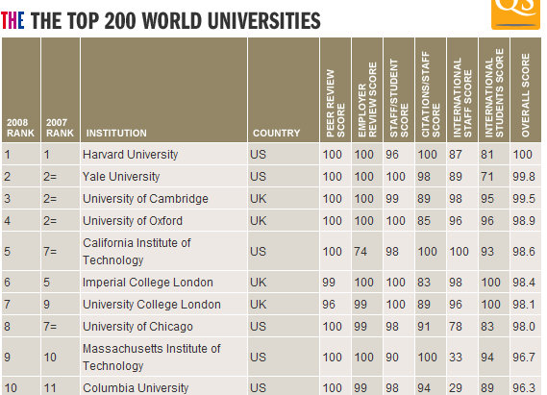
Times

Slide 33
WHAT CAUSES THE GLOBAL RANKINGS AND WHAT THE IMPLICATION TO EDUCATIONAL PRACTICES?
The "Impact of Globalization "
Borrowing and lending reform strategies
In comparative education, there is a great need to examine how local reactions are to these external global forces .
In policy studies, a new paradigm for educational policy-making and school reform is expected to be under way.

Slide 34
What can be learned and imported from elsewhere? (borrowing)
What can be taught and exported elsewhere? (lending),
The phenomena of cross-national policy attraction and educational borrowing
Global and international convergence in education at the expense local needs and cultural diversity

Slide 35
Taipei - Taiwan and China are to hold a second round of high- level talks in Taipei for five days from Monday November 3 to 7. Following is a schedule of main events:
Monday - China's top negotiator with Taiwan, Chen Yunlin, leads a 74-member delegation to Taiwan on a weekend charter flight. Check in at Grand Hotel, and his deputies will hold preparatory talks with their Taiwanese counterparts in the afternoon….

Slide 36
ROC (Taiwan) vs. PRC (China): A Comparison
Taiwan is formally known as the Republic of China (ROC). The ROC is Asia's first constitutional republic, founded in 1912. When the Chinese Communist Party established the People's Republic of China (PRC) on the Chinese mainland in 1949, the ROC government, led by the Kuomintang (KMT), relocated to Taiwan, where it maintained jurisdiction over Taiwan, Penghu, Kinmen, Matsu, and numerous other islets.

Slide 37
The two sides of the Taiwan Strait have since been governed as separate territories and developed separate identities.
In the realm of political development, Taiwan has grown into a free and vibrant democracy. The government lifted martial law in 1987 and launched a series of political reforms to expand the democratic process. In 1996, the people of Taiwan completed their first direct presidential election. The presidential election of 2000 and 2008 were peacefully transferred power between Democratic Progressive Party (DPP) and KMT.

Slide 38
In contrast, the advancement of democracy in China has stagnated, and the PRC remains a one-party Communist dictatorship.

Slide 39
A Statistical Comparison (2001)
TAIWAN (Republic of China)
13,969 square miles
pop: 22.42 million
US$ 12,000 (14,000)
Global growth competitiveness7th / 75
Mobile phone penetration rate 96.6%
CHINA (People’s Republic of China)
3,706,566 square miles
Pop:1.27 billion
Per capita GNP US$840
Global growth competitiveness39th / 75
Mobile phone penetration rate11.2%

Slide 40
Education in 2020
What will happen to the next generations of China, Taiwan and the USA after a series of nation-wide educational reforms?
What are the follow-ups and outcomes?
Who benefit and who suffer as a result of these reform programs ?
What do learn from each other?

Slide 41
Q & A

Slide 42
Thank you for your attention.
God Bless!
Chuing Prudence Chou (周祝瑛)
Professor, Cheng-chi University, Taiwan
Email: iaezcpc@nccu.edu.tw
Nov. 3 , 2008

